Slide 1
Cyber Security Project NMAP (Network Mapper)

Slide 2


Slide 3
What is Nmap?
Description:
Nmap stands for Network Mapper. It’s an open-source utility developed by Gordon Lyon (also known as Fyodor).
Nmap is used to discover hosts and services on a computer network by sending packets and analyzing the responses.
Nmap is Open-source tool for network discovery and security auditing.
Helps organizations identify devices, services, and vulnerabilities.
Widely used in cybersecurity assessments.

Slide 4
Problem Statement
Challenges in Network Security:
Lack of visibility into assets and services.
Difficulty detecting unauthorized devices.
Compliance with standards (GDPR, PCI DSS).
Risk of data breaches and unauthorized access
Mobile Malware & BYOD Risks
Human Error
Insider Threats

Slide 5
Nmap – Solution Overview
Nmap Helps:
Detects hosts, ports, services, and versions.
Scans for vulnerabilities.
Automates network assessment tasks.
Supports scripting and reporting.

Slide 6
Key Features:
Network Discovery: Detects live hosts and open ports.
Service Detection: Identifies services and versions.
Vulnerability Assessment: Finds known vulnerabilities.
Scripting Engine (NSE): Automates scans.
Reporting: Saves results in multiple formats.
OS Fingerprinting.
Scan Timing & Performance Control.

Slide 7
Project Objective:
To investigate and demonstrate the practical applications of Nmap in network reconnaissance, vulnerability assessment, and ethical hacking, by creating a comprehensive, scenario-driven presentation that equips learners with real-world scanning techniques and analytical skills.
Goal:
Use Nmap to perform a network scan and identify:
Active hosts
Open ports
Running services and versions
Potential vulnerabilities

Slide 8
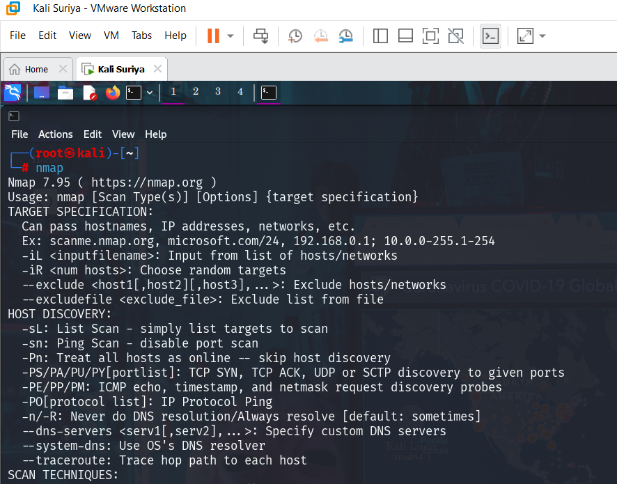
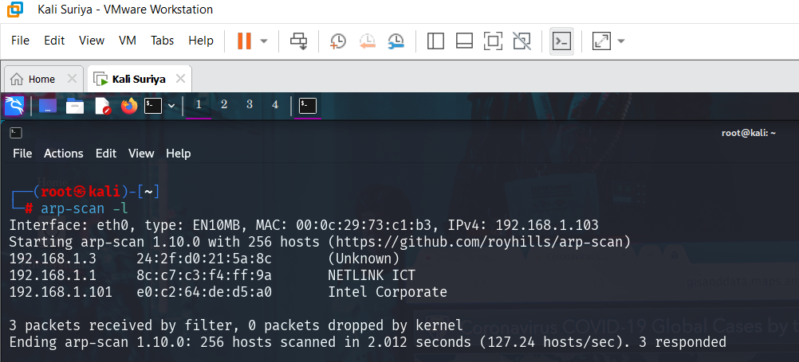
Nmap Specification:
Target Specification:
nmap is a network scanning tool used to discover hosts and services on a network by sending packets and analyzing responses.
arp-scan -l
Scans the local network for active devices using ARP requests.

Slide 9
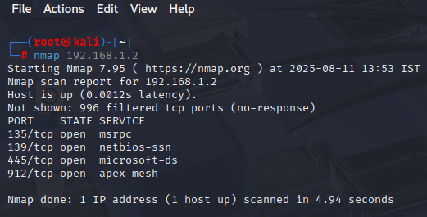
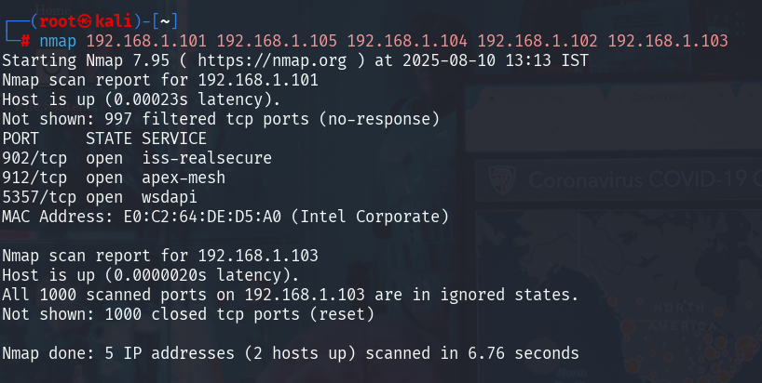
nmap 192.168.1.2
Scans the host at IP 192.168.1.2 for open ports.
nmap 192.168.1.101 192.168.1.105 192.168.1.104 192.168.1.102 192.168.1.103
Scans multiple specific IP addresses for open ports.

Slide 10
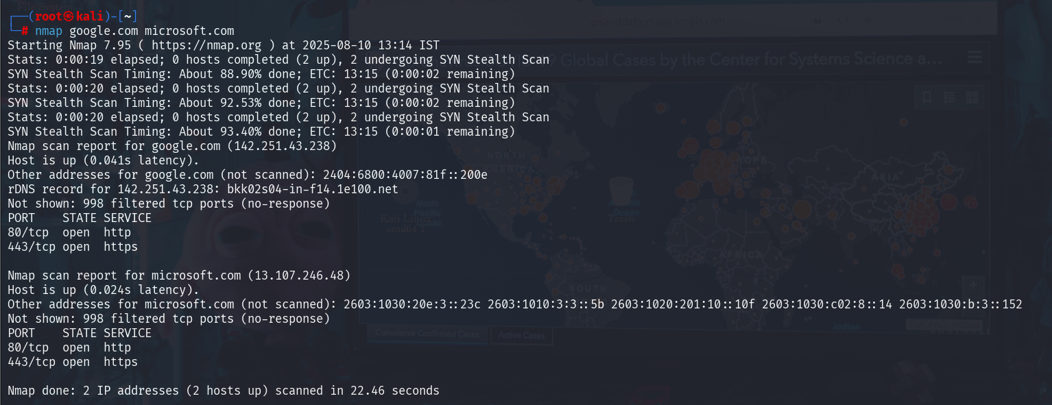
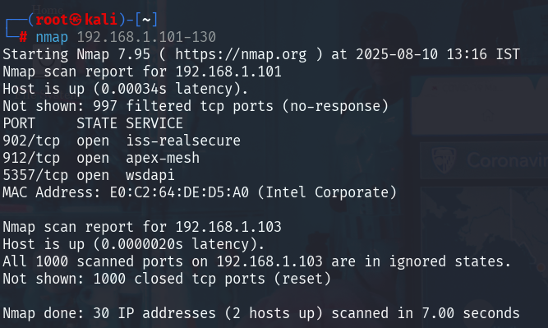
nmap google.com microsoft.com
Performs a port scan on both Google and Microsoft domains
nmap 192.168.1.101-130
Scans a range of IPs from 192.168.1.101 to 192.168.1.130

Slide 11
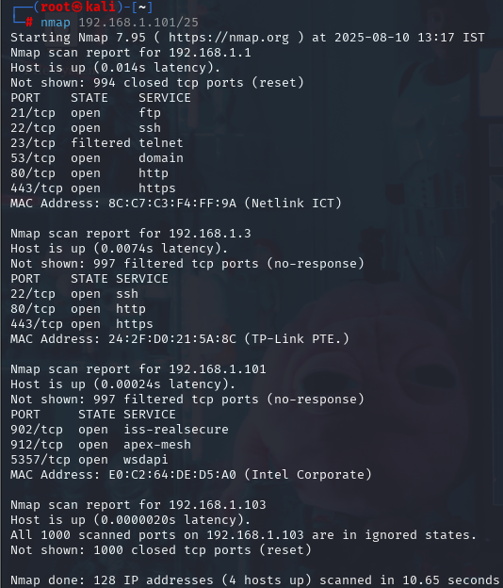

nmap 192.168.1.137/25
Scans all 128 IP addresses in the 192.168.1.0/25 subnet.
nano file.txt
Opens the Nano editor to create or edit file.txt, typically to store target IPs.

Slide 12
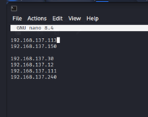
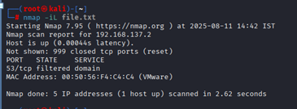
nmap -iL file.txt
Reads target IPs or domains from file.txt and scans them.

Slide 13
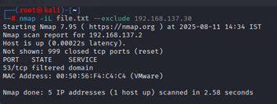
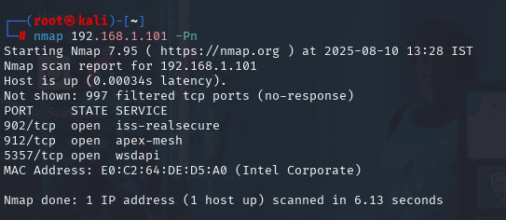
nmap -iL file.txt --exclude 192.168.1.30
Scans targets from file while excluding 192.168.1.30.
Host Discovery:
nmap 192.168.1.101 -Pn
Skips host discovery (ping) and treats the host as online.

Slide 14
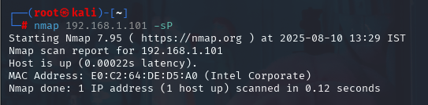
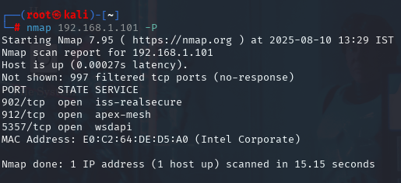
nmap 192.168.1.101 -sP (deprecated)
Performs a ping scan to check if the host is up (use -sn in newer versions).
Port specification:
nmap 192.168.1.101 -P
Invalid or incomplete option — possibly a typo or incomplete command.

Slide 15
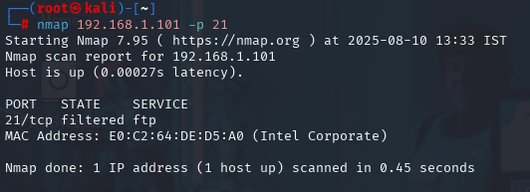
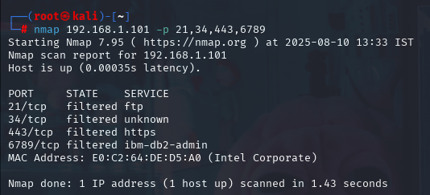
nmap 192.168.1.101 -p 21
Scans only port 21 (FTP) on the target host.
nmap 192.168.1.101 -p 21,34,443,6789
Scans specific ports (21, 34, 443, 6789).

Slide 16
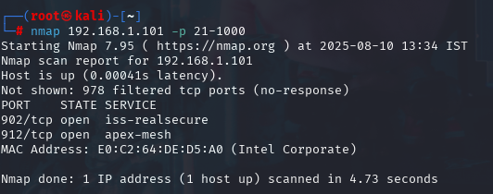
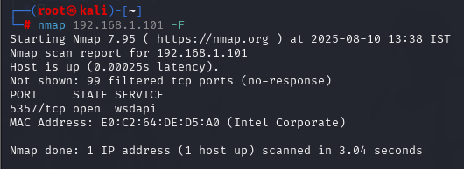
nmap 192.168.1.101 -p 21-1000
Scans all ports from 21 to 1000.
nmap 192.168.1.101 -p-
Scans all 65535 TCP ports on the host.
nmap 192.168.1.101 -F
Performs a fast scan using the top 100 common ports.

Slide 17
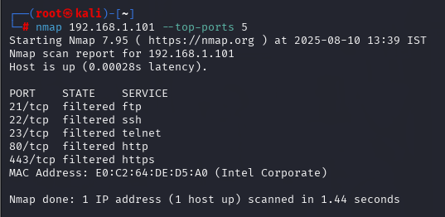
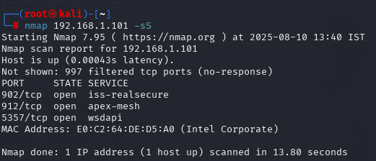
nmap 192.168.1.101 --top-ports 5
Scans the top 5 most common ports.
Scanning techniques:
nmap 192.168.1.101 -sS
Performs a stealth SYN scan (default for privileged users)

Slide 18
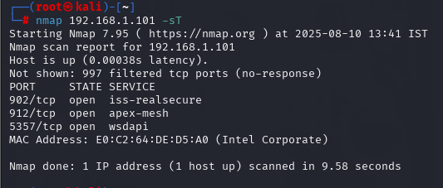
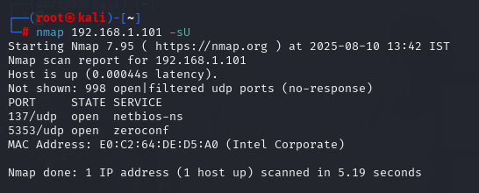
nmap 192.168.1.101 -sT
Performs a full TCP connect scan (used when SYN scan isn't possible)
nmap 192.168.1.101 -sU
Performs a UDP port scan.

Slide 19
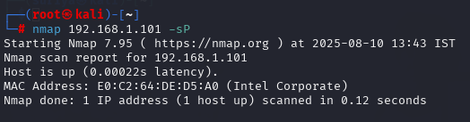
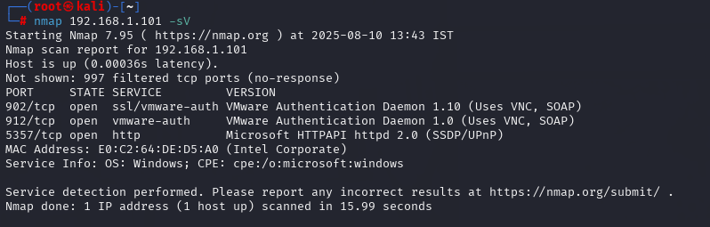
nmap 192.168.1.101 -sP (duplicate and deprecated)
Same as earlier – performs a ping scan to detect live hosts.
nmap 192.168.1.101 -sV
Detects versions of services running on open ports.

Slide 20
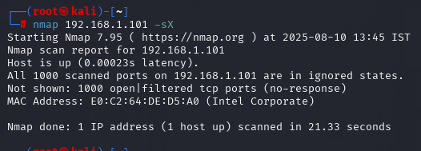
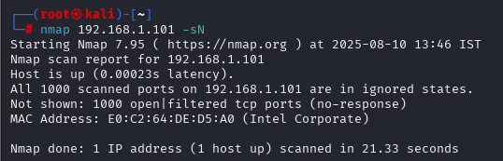
nmap 192.168.1.101 -sX
Performs a Xmas scan (sends unusual flags) to evade detection.
nmap 192.168.1.101 -sN
Performs a Null scan (no flags set) to detect open ports

Slide 21
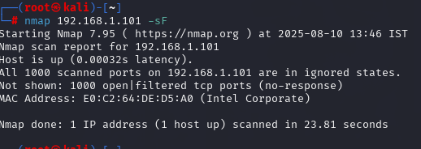
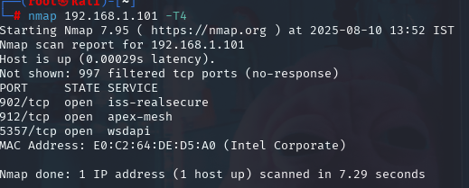
nmap 192.168.1.101 -sF
Performs a FIN scan (sends only FIN flag packets).
Timing Scan:
nmap 192.168.1.101 -T0
Executes the scan very slowly (paranoid mode) to avoid detection.
nmap 192.168.1.101 -T4
Executes a faster scan, recommended for LANs.
nmap 192.168.1.101 -T1
Executes a very slow scan (sneaky mode) to evade IDS/IPS.
nmap 192.168.1.101 -T2
Executes a slow scan (polite mode) to reduce load on the target.
nmap 192.168.1.101 -T5
Executes the fastest scan (aggressive), may cause false positives

Slide 22
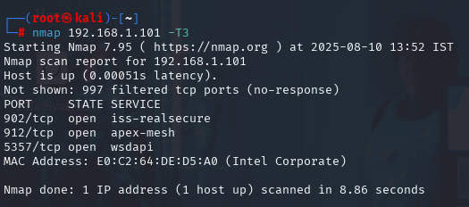
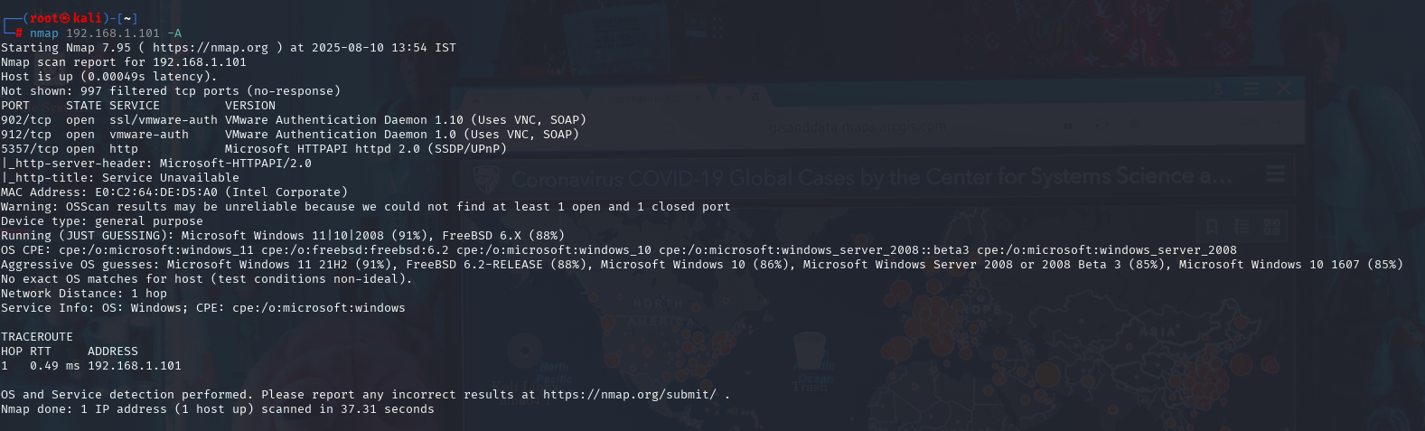
nmap 192.168.1.101 -T3
Default scan timing (normal speed).
nmap 192.168.1.101 -A
Enables OS detection, version detection, script scanning, and traceroute.

Slide 23
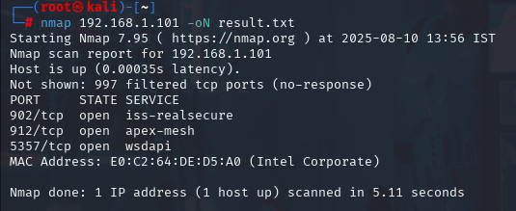
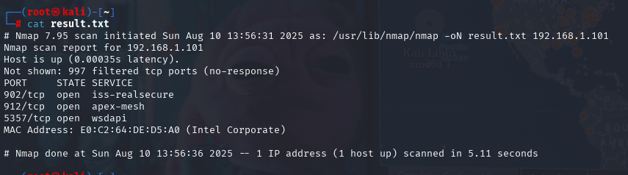
Output:
nmap 192.168.1.101 -oN result.txt
Saves the scan output in a normal (readable) format to result.txt.
cat result.txt
Displays the contents of the scan output file result.txt.

Slide 24
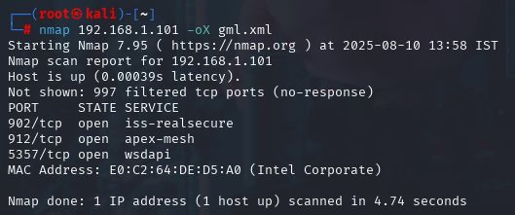
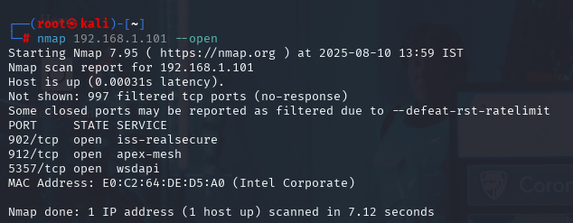
nmap 192.168.1.101 -oX gml.xml
Saves the scan output in XML format to gml.xml.
nmap 192.168.1.101 -oA red
Saves output in all formats (normal, XML, grepable) with base filename red.
nmap 192.168.1.101 --open
Shows only hosts with open ports.

Slide 25
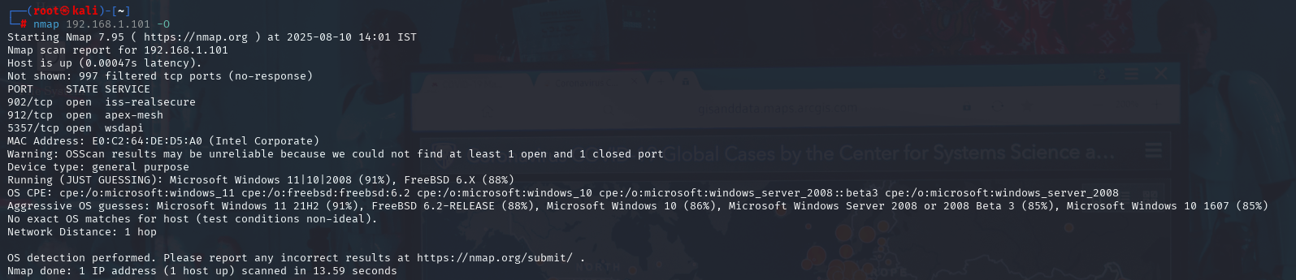
nmap 192.168.1.101 -O
Attempts to detect the operating system of the target.
nmap 192.168.1.101 ndiff >compare two files
Compares two Nmap scan results using ndiff to show differences.

Slide 26
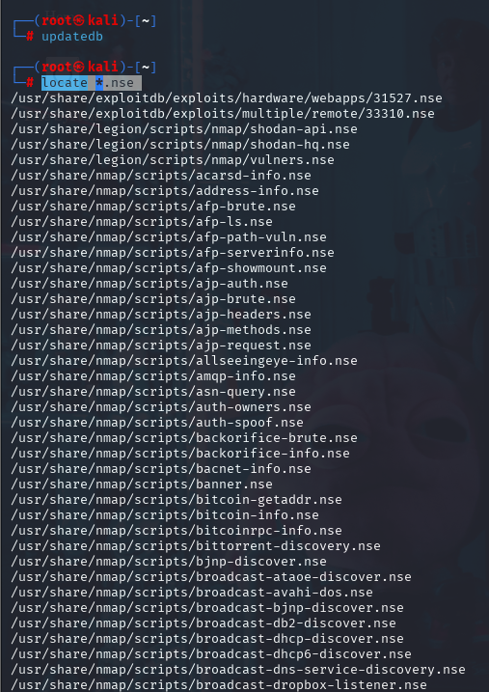
Scripting for Nmap:
updatedb
Updates the database used by the locate command.
locate *.nse
Lists all Nmap Scripting Engine (*.nse) scripts available on the system.

Slide 27
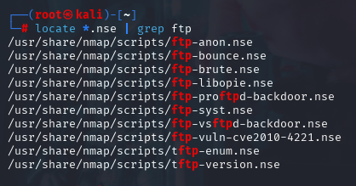
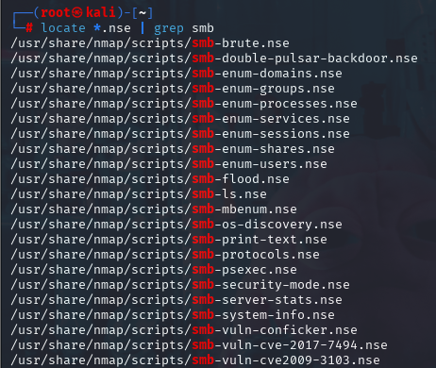
locate *.nse | grep ftp
Filters NSE scripts related to FTP.
locate *.nse | grep smb
Filters NSE scripts related to SMB.

Slide 28
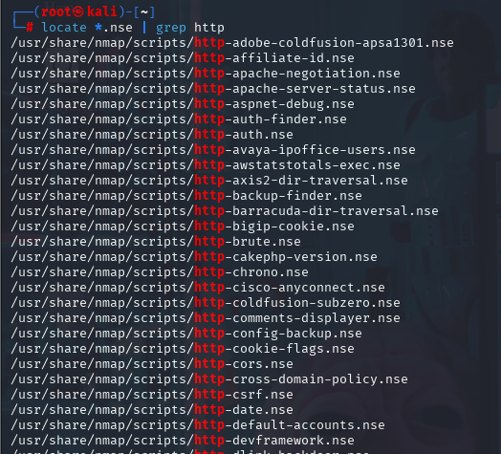

locate *.nse | grep http
Filters NSE scripts related to HTTP.
cat /usr/share/nmap/scripts/http-vuln-wnr1000-creds.nse |grep " --script "
Shows how the NSE script is invoked using the --script option.

Slide 29
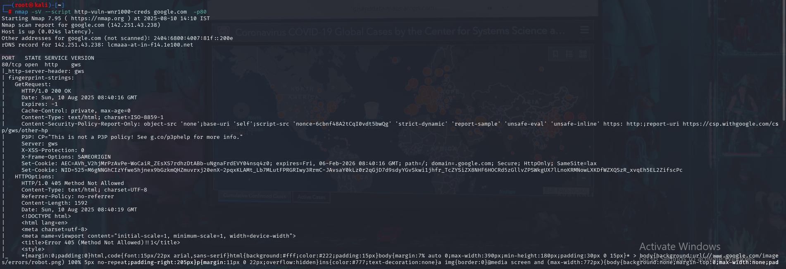
nmap -sV --script http-vuln-wnr1000-creds google.com -p80
Runs a specific script (http-vuln-wnr1000-creds) against Google on port 80 to check for vulnerability.

Slide 30
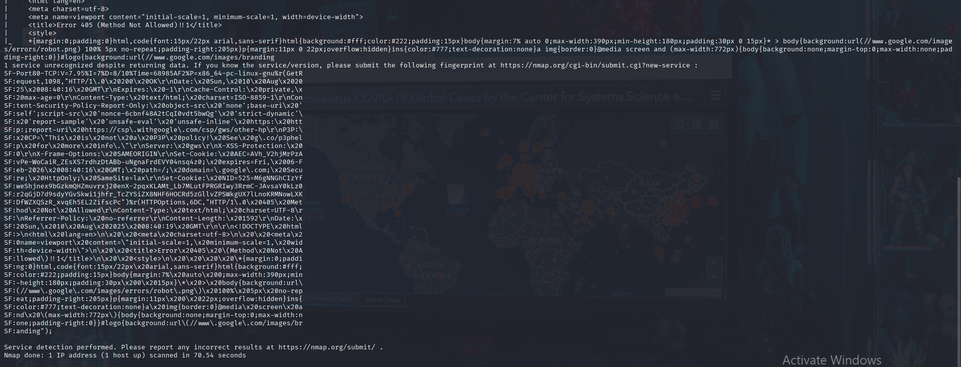

Slide 31
Analysis:
Findings:
Apache web server is outdated,
SSH service open — needs strong password policies.
Unnecessary ports exposed.
Risks:
Exploitable services.
Misconfigurations.
Non-compliance with security standards.

Slide 32
Recommendations:
Close unused ports: Use Nmap to identify open ports
Update vulnerable services: Regularly patch and update software to fix known vulnerabilities.
Use firewall rules: Implement strict inbound and outbound filtering
Regular scans using Nmap: Schedule periodic scans to detect changes in network exposure.
Integrate with SIEM tools: Correlate scan data with logs and alerts for deeper threat analysis.

Slide 33
ROI & Value of Nmap
Risk Mitigation: Identifies threats early.
Efficiency: Automates assessments.
Compliance: Supports audits and standards.
Cost-effective: Free, open-source, widely supported.
Comprehensive Visibility:Identifies live hosts, open ports, running services, and OS fingerprints.
Automation & Integration: Easily integrates with SIEM tools (e.g., Splunk, ELK, QRadar) for continuous monitoring.
Operational Impact: Enhances incident response by providing rapid network reconnaissance.

Slide 34
Conclusion:
Nmap is far more than a simple port scanner—it’s a versatile, powerful tool that plays a critical role in modern network security. Through this project, we’ve demonstrated how Nmap can:
Discover active hosts and services.
Identify open ports and service versions.
Detect potential vulnerabilities using scripting and automation.
Support regular assessments, compliance efforts, and incident response.

Slide 35
Thank You!!

